Slide 1
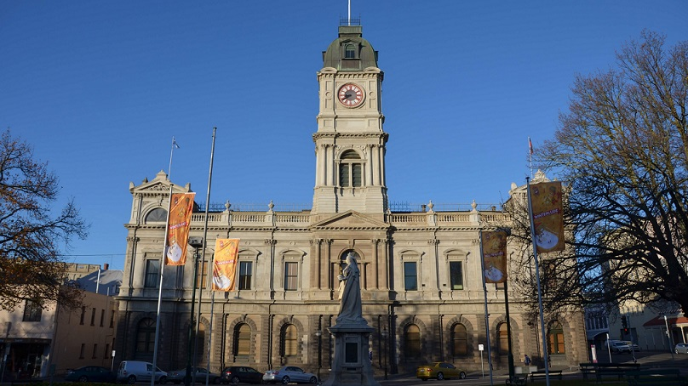
Learning at City of Ballarat
Where we are at now and where we are going.

Slide 2
Background
Regional city about an hour from Melbourne
Known for our Gold Rush era history as evident in the large number of 1850s-1880s heritage buildings
Lies on Wadawurrung and Dja Dja Warrung country, with strong First Nations community
Notes:
Ballarat is Victoria’s largest inland city. The municipal district encompasses the City of Ballarat and several other smaller townships as well as an large rural area covering 740 square kilometres.
The city has a strong First Nations history and, today, has a thriving and active community Aboriginal Community. The Wadawurrung and Dja Dja Wurrung people are the Traditional Custodians. Ballarat is also renowned for its Gold Rush era history with a rich and unique heritage apparent in the architecture of the City.
As well as being a popular destination for Victorian, interstate and international tourists, the key industries include health care and social assistance, professional, scientific and technical services, education and training, construction and manufacturing.

Slide 3
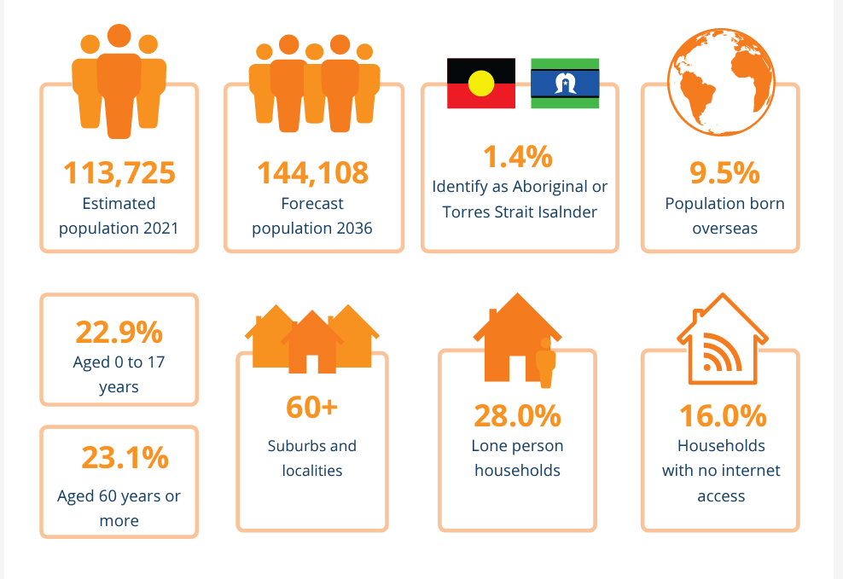
Demographics
Period of accelerated growth – sped up due to Covid
Growing diversity
High percentage of single person households
Significant pockets of both highly advantaged communities and highly disadvantaged pockets
High levels of chronic illness
Notes:
The City’s population of 113,725 (2021) has grown by almost 20 per cent in the past 10 years and is forecast to grow by a further 27 per cent to more than 144,000 by 2036.
Notably, the City’s population is characterised by the disparity in socio-economic status (SES), with some suburbs having relatively high levels of education, employment, and income, while others (e.g., Wendouree, Sebastopol, Redan) are among the 2.5 per cent most disadvantaged areas in the state – with low levels of employment, literacy, income, and wellbeing.

Slide 4
Education and Learning
Public and Private schools
Universities
TAFE and Vocational learning
Informal learning facilities
Council operated learning facilities – libraries, gallery, museum
Neighbourhood houses
Others
Notes:
Ballarat is a regional education hub with a wide range of state and independent primary and secondary schools, including schools which have boarders from the rural areas around Western Victoria. The town also boasts two regional university campuses as well as a Melbourne Univeristy Medical School's Rural Medical Clinic for training doctors. There are a wide range of other education providers both formal and informal including neighbourhood houses and libraries. Despite this, Ballarat's demographic profile shows that education levels are lower than the state average.

Slide 5
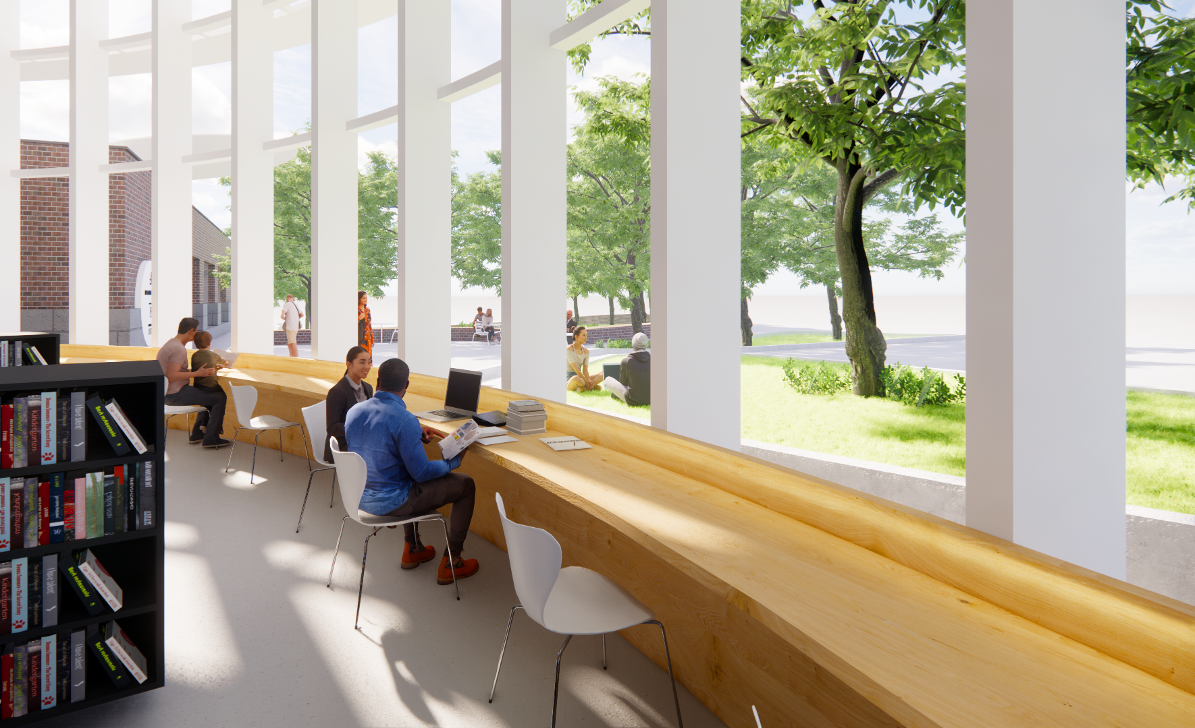
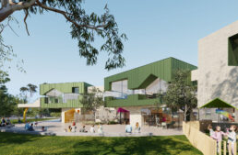
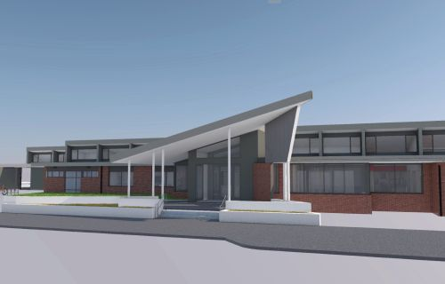
An expanding library and learning service
Newly refurbished and expanded central library
Plans for vastly expanded Wendouree Library
Plans for new library at western growth zone (Delacombe)
Community Hubs
Existing location Lucas – co-located with kinder and MCHN
Alfredton opening Jan 2024 – co-located with kinder and MCHN
Sebastopol late 2025 – co-located with Senior Citizens
Buninyong 2026/7
Notes:
The City of Ballarat Libraries and Lifelong Learning business unit has been focused for the last 4 years on delivering on the Libraries and Learning Strategy 2022-2027. One of the major goals within this plan was the redevelopment and re-opening of the central Ballarat Library, the largest of 3 library branches within the LGA. This project had been many years in the planning, with the building and construction phase taking approximately 15 months. The central branch re-opened in late March 2024 and has now been operating for over 12 months.
In that time the library has added 6000+ new members bring library membership to approximately 40% of the Ballarat population. The redevelopment has allowed the Libraries and Lifelong Learning team to expand and diversify learning programs for audiences of all ages.
In addition to the re-opening of Ballarat Library, the Libraries and Lifelong Learning team has taken over the management of one existing community hub and one brand new community hub, both located in the Western Growth zone in Ballarat. These community hubs offer co-located services including Maternal and Child Health and Kindergartens as well as providing a range of no or low-cost learning programs. Partnerships between the City of Ballarat and several local Neighbourhood Houses has allowed for these programs to be available at a number of locations throughout the city. Over the next three years there will be a further 2-3 community hubs built within the LGA.

Slide 6
Partnerships focus
Expand the learning programs offered by leveraging local expertise
Connect with hard to reach community groups
Bring new groups into the library or Community Hub
Take the library to other places – digital literacy, STEM Maker grant
Notes:
The Libraries and Lifelong Learning team have focused on developing strong partnerships with individuals, groups and organisations both in Ballarat and more broadly across Victoria to establish opportunities and programs for our community in areas of need. One example of this is the grant that Geelong-based STEM company, The Brainary, won in partnership with Ballarat Libraries, Ballarat and District Aboriginal Cooperative and Ballarat Regional Multi-Cultural Council, to deliver STEM programs for 12-18 year olds. This program specifically targets young people from communities with low representation in STEM careers, including Aboriginal and Torres Strait Islanders, culturally and linguistically diverse young people, girls and gender diverse young people and those from low socio-economic neighbourhoods. The program will be rolled out to 150 young people across the LGA over the next 12 months and will give young people access to new and emerging technologies and introduce them to a range of STEM careers that they could pursue.
Another example of the strong partnerships we have been building on is the highly successful children literacy program, Bulldogs Read, with 150 participating students across 10 primary schools. This program, a partnership between City of Ballarat and Western Bulldogs Football Club, is now in it's 10th year and has been highly successful with school reporting increased literacy skills and confidence in students enrolled in the program.

Slide 7
Working with internal networks
Aging Well
Seniors Festival
Seniors Expo
Youth Services
Popcon
Young Eventsters cooking program
Art Gallery of Ballarat – currently closed for renovations so using the library for their children's education programs
Children's and Family Services
Parent Place outreach
Aboriginal Children's Day
Sustainable Environment
Thermal Camera and sustainable home programs, Electrify your home programs
Volcano Dreaming project
Customer Experience
Snap, Send and Solve
Emeargency Management
Get Techy, Get Ready – preparing for emergenciens

Slide 8
Going beyond council
Neighbourhood Houses
4 suburban Neighbourhood Houses
Strong relationship with Wendouree – serving a very disadvantaged community
Sharing resources and staff expertise
Venue
Western Bulldogs Football Club
Bulldogs Read school literacy program
Be Connected/Good Things Foundation
Grants for digital literacy programs for over 50s
The Brainary
STEM Maker program
Smart Living Ballarat and BREAZE
Sustainability education
Thermal cameras and other home energy equipment
Ballarat Marathon
Benefits of running for wellbeing
Ballarat Autism Network
Sensory Storytime

Slide 9
Where to from here?
Developing new partnerships to offer a more diverse range of programs
Staged development of Community Hubs 2024-2027
Advocating for new, much larger library at Wendouree
New library in the Western Growth Zone (Delacombe)
Expansion of library services with innovative models and outreach services in outlying areas
Notes:
In terms of future development, along with the opening of more community hubs, the City of Ballarat is advocating strongly for funding for a new Wendouree Library. Wendouree is an area with very low socio-economic, employment, health and education outcomes and the existing library, within the local shopping centre, is inadequate for the community it serves. A new, much larger library branch would offer co-located services, a larger library collection, expansive community meeting room and learning spaces, technology and maker space and dedicate areas for child and young adults. This is a long term project and, like the redevelopment of Ballarat Library, will take years to plan, develop and build, but will have an enormous impact on the community.

