Slide 1
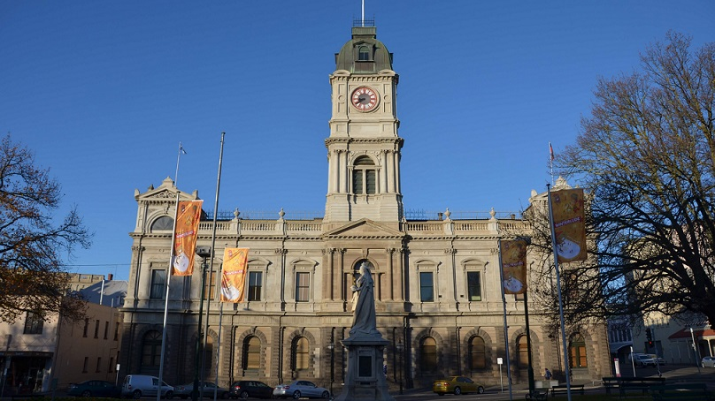
Learning at City of Ballarat
Where we are at now and where we are going.

Slide 2
Background
Regional city about an hour from Melbourne
Known for our Gold Rush era history as evident in the large number of 1850s-1880s heritage buildings
Lies on Wadawurrung and Dja Dja Warrung country, with strong First Nations community

Slide 3
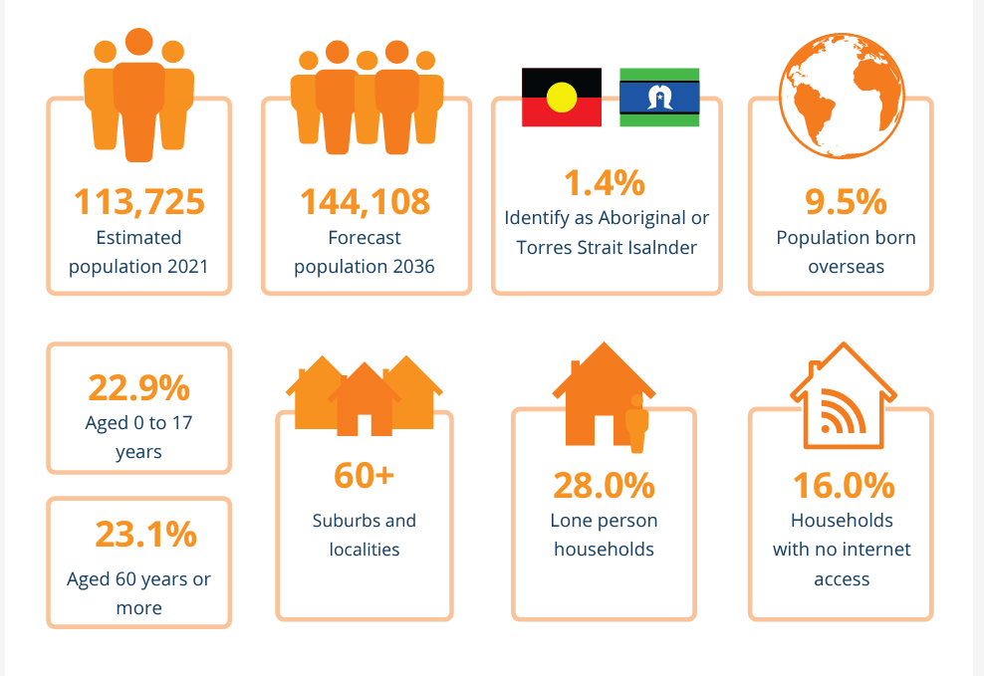
Demographics
Period of accelerated growth – sped up due to Covid
Growing diversity
High percentage of single person households
Significant pockets of both highly advantaged communities and highly disadvantaged pockets
High levels of chronic illness

Slide 4
Education and Learning
Public and Private schools
Universities
TAFE and Vocational learning
Informal learning facilities
Council operated learning facilities – libraries, gallery, museum
Neighbourhood houses
Others

Slide 5
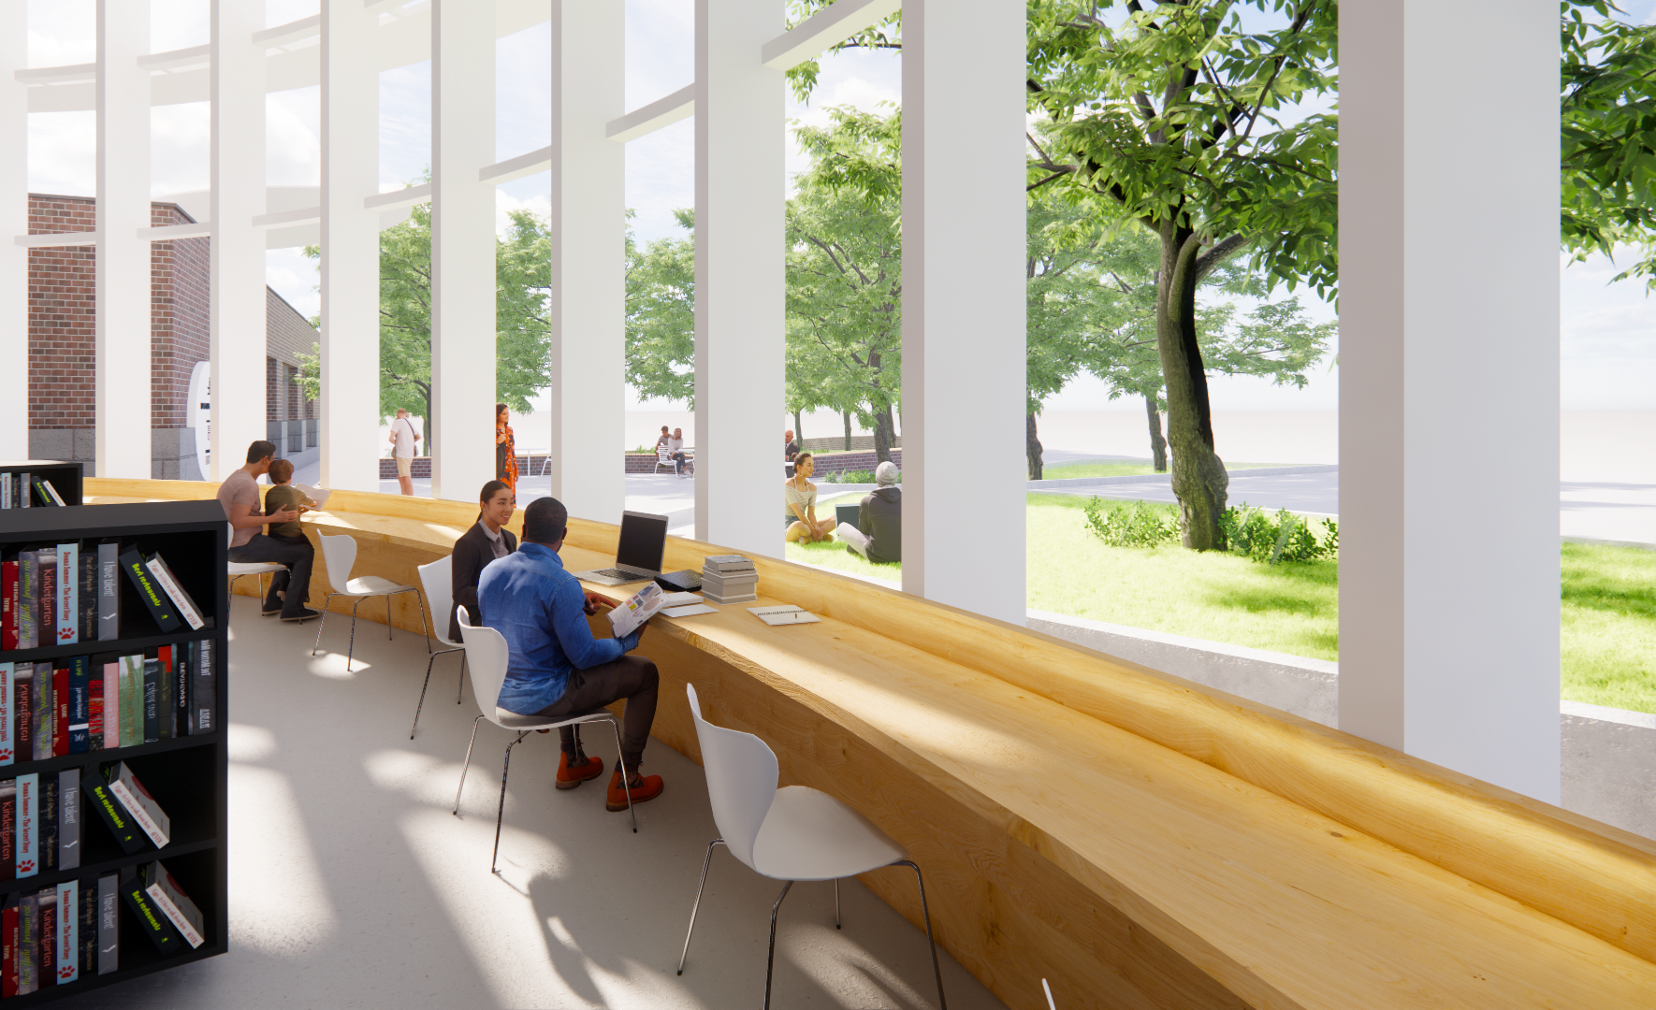
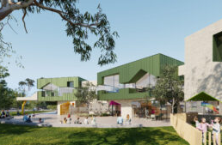
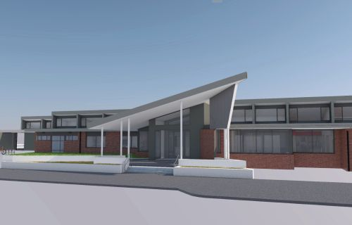
An expanding library and learning service
Newly refurbished and expanded central library
Plans for vastly expanded Wendouree Library
Plans for new library at western growth zone (Delacombe)
Community Hubs
Existing location Lucas – co-located with kinder and MCHN
Alfredton opening Jan 2024 – co-located with kinder and MCHN
Sebastopol late 2024 – co-located with Senior Citizens
Buninyong 2025/6

Slide 6
Partnerships focus
Expand the learning programs offered by leveraging local expertise
Connect with hard to reach community groups
Bring new groups into the library or learning centre
Take the library to other places – digital literacy

Slide 7
Working with internal networks
Aging Well
intergenerational storytime/writing competition
digital literacy
Youth Services
Popcon
Co-located progras
Dungeons and Dragons
Eureka Centre
Referendum education programs
Art Gallery of Ballarat
Children's and Family Services
Parent Place outreach
Aboriginal Children's Day
Sustainable Environment
Thermal Camera and sustainable home programs
Customer Experience
Snap, Send and Solve
Neuron Mibility – Scooter Trial
Emeargency Management
Get Techy, Get Ready – preparing for emergenciens

Slide 8
Going beyond council
Neighbourhood Houses
4 suburban Neighbourhood Houses
Strong relationship with Wendouree – serving a very disadvantaged community
Sharing resources and staff expertise
Venue
Western Bulldogs Football Club
Bulldogs Read school literacy program
Services Victoria/Services Australia
My Gov App sessions
Getting reading for retirement
Understanding Youth Allowance
Tenant rights
Clemente (Fed Uni, ACU, Smith Family, Ballarat Foundation and City of Ballarat)
Program aimed at engaging individuals experiencing disadvantage with univeristy level courses in a supported and safe place.
Be Connected/Good Things Foundation
Grants for digital literacy programs for over 50s
The Brainary
Coding, Robotics
Programs for school aged children
Coding and robotics for seniors
Food is Free
Vic Health grant to incorporate community garden at Sebastopol Library
Workshops on home veggie gardening
Smart Living Ballarat
Sustainability education
Thermal cameras and other home energy equipment
Job Victoria
Job readiness programs
NBN Co
Monthly Tech Café program
Ballarat Hacker's
Creative technology programs

Slide 9
Where to from here?
Developing new partnerships to offer a more diverse range of programs
Opening of the expanded Ballarat Library in 2024
Staged development of Community Hubs 2024-2026
Formalisation of internal and external learning networks
Developing a learning festival – 2024/2025
Learning needs analysis for the LGA to guide future planning
Developing a learning framework to sit alongside the Libraries and Lifelong Learning Strategy
UNESCO Learning City?

